Slide 1
Embedded System Introduction
.

Slide 2
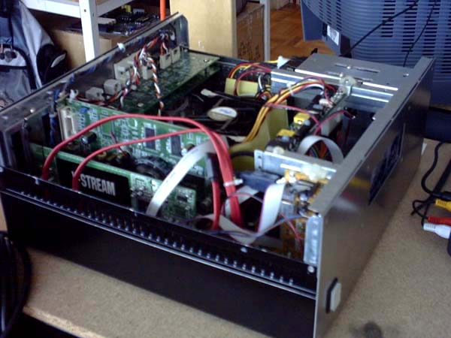
What is an embedded system?
According to the Institution of Electrical Engineers, "A general purpose definition of embedded systems is that they are devices used to control, monitor or assist the operation of equipment, machinery, or plant. 'Embedded' reflects the fact that they are an integral part of the system..." An embedded system is a special-purpose computer system, which is completely encapsulated by the device it controls. An embedded system has specific requirements and performs pre-defined tasks, unlike a general-purpose personal computer.

Slide 3
Microcontrollers and Embedded System
Embedded Systems are a combination of Hardware (microcontrollers) and Software (developed in assembler, c, c++…) designed to perform a specific function
An embedded product uses microcontrollers to do one task and one task only.

Slide 4
Components of Embedded Systems
Hardware 2. Software 3. Firmware
So we can define an embedded system as a Microcontroller based, software driven, reliable, real-time control system.

Slide 5
Characteristics of an Embedded System:
Single-functioned − An embedded system usually repeats a specialized operation.
For example: A pager always functions as a pager.
Tightly constrained − All computing systems have constraints on design metrics like cost, size, power, and performance but those on an embedded system can be especially tight. Design metrics is a measure of an implementation's features. It must be of a size to fit on a single chip, must perform fast enough to process data in real time and consume minimum power to extend battery life.

Slide 6
Reactive and Real time − Many embedded systems must continually react to changes in the system's environment and must compute certain results in real time without any delay.
For example, a car cruise controller that continually monitors and reacts to speed and brake sensors. It must compute acceleration or decelerations repeatedly within a limited time; a delayed computation can result in failure to control of the car.
Microprocessors based − It must be microprocessor or microcontroller based.
Memory−It must have a memory, as its software usually embeds in ROM. •
Connected − It must have connected peripherals to connect input and output devices.
HW-SW systems − Software is used for more features and flexibility. Hardware is used for performance and security

Slide 7
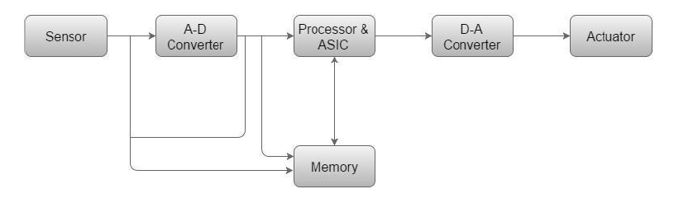
Basic Structure of an Embedded System
Sensor − It measures the physical quantity and converts it to an electrical signal which can be read by an observer or by any electronic instrument like an A-D converter. A sensor stores the measured quantity to the memory.
• A-D Converter − An analog-to-digital converter converts the analog signal sent by the sensor into a digital signal.
• Processor & ASICs − Processors process the data to measure the output and store it to the memory. • D-A Converter − A digital-to-analog converter converts the digital data fed by the processor to analog data • Actuator − An actuator compares the output given by the D-A Converter to the actual (expected) output stored in it and stores the approved output

Slide 8
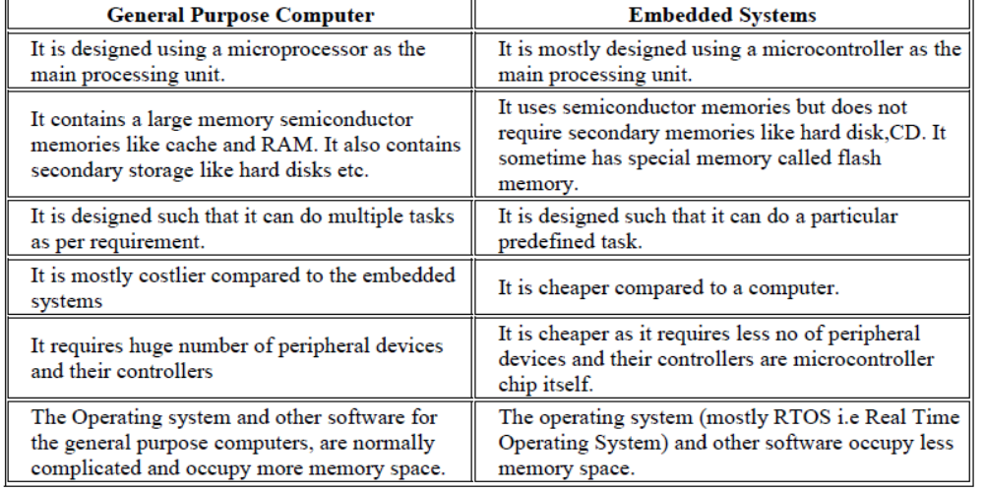
Difference between General purpose computer and Embedded systems:

Slide 9
Advantages
• Smallsize
• Lowpowerconsumption
• Lowcost
• Enhanced performance
• Easily customizable
Disadvantages
• Highdevelopment effort
• Larger time to market

Slide 10
Purpose of Embedded Systems:
Each Embedded Systems is designed to serve the purpose of any one or a combination of the following tasks.
o Data Collection/Storage/Representation
o Data Communication
o Data (Signal) Processing o Monitoring
o Control
o Application Specific User Interface

Slide 11
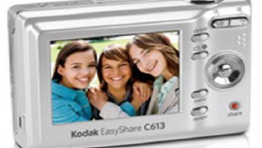
Data Collection/Storage/Representation:-
Performs acquisition of data from the external world. ❖ The collected data can be either analog or digital ❖ Data collection is usually done for storage, analysis, manipulation and transmission ❖ The collected data may be stored directly in the system or may be transmitted to some other systems or it may be processed by the system or it may be deleted instantly after giving a meaningful representation

Slide 12
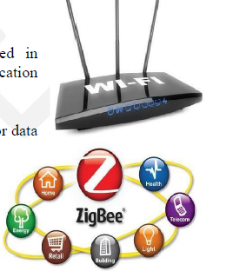
Data Communication:-
Embedded Data communication systems are deployed in applications ranging from complex satellite communication systems to simple home networking systems Embedded Data communication systems are dedicated for data communication The data communication can happen through a wired interface (like Ethernet, RS-232C/USB/IEEE1394 etc) or wireless interface (like Wi-Fi, GSM,/GPRS, Bluetooth, ZigBee etc) Network hubs, Routers, switches, Modems etc are typical examples for dedicated data transmission embedded systems

Slide 13
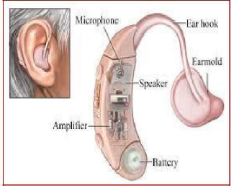
Data (Signal) Processing:-
Embedded systems with Signal processing functionalities are employed in applications demanding signal processing like Speech coding, synthesis, audio video codec, transmission applications etc Computational intensive systems Employs Digital Signal Processors (DSPs)

Slide 14
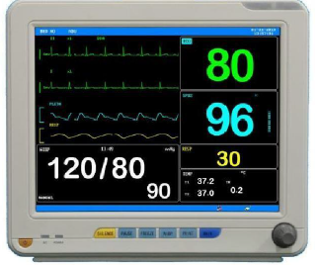
Monitoring:-
Embedded systems coming under this category are specifically designed for monitoring purpose They are used for determining the state of some variables using input sensors They cannot impose control over variables. Electro Cardiogram (ECG) machine for monitoring the heart beat of a patient is a typical example for this The sensors used in ECG are the different Electrodes connected to the patient‟s body Measuring instruments like Digital CRO, Digital Multi meter, Logic Analyzer etc used in Control & Instrumentation applications are also examples of embedded systems for monitoring purpose

Slide 15
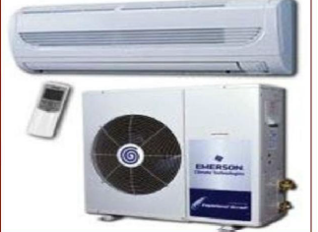
Control:-
Embedded systems with control functionalities are used for imposing control over some variables according to the changes in input variables Embedded system with control functionality contains both sensors and actuators Sensors are connected to the input port for capturing the changes in environmental variable or measuring variable The actuators connected to the output port are controlled according to the changes in input variable to put an impact on the controlling variable to bring the controlled variable to the specified range .

Slide 16
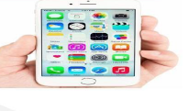
. Application Specific User Interface:-
Embedded systems which are designed for a specific application Contains Application Specific User interface (rather than general standard UI ) like key board, Display units etc Aimed at a specific target group of users Mobile handsets, Control units in industrial applications etc are examples.

Slide 17
Interactive Vehicle Tracking System
It is a system which can track the vehicles for its movement through out the trip with GPS And GPRS.
The data collected at different data points are stored at the vehicle itself and in the computers of respective data points then to the server.
The Data are
vehicle number, started time, stop time, Fuel at, Date, Fuel type, Qty, Amount, Balance, Driver ID …..
The Data Points are
the places where the interactive RF transmitter and receivers are fixed say BPCL fuel stations.

Slide 18


At the data points
GPS & GPRS based RF transmitter and receivers (RF System) are connected to a computers
GPS system is capable of interacting over area of 1 square metre
The GPS will transmit the data in a periodic interval continuously from the data point

Slide 19
Server
Block diagram of data locker
Receiver
Memory
D i s p l a y
GPS & GPRS
Micro
Controller
Transmitter
sensors
Start/stop
alarm
Load
Fuel

Slide 20
Block diagram of data point
Server
Receiver
GPS & GPRS
SMS
Micro
Controller
Printer
Transmitter
Pump
Pump link circuit

Slide 21
Advantages
  Compatible with any SMART cards
  Data is stored at data point (fuel station computer) and at the vehicle
  Vehicle owners can verify trip data from their office
  Data can be online with server
  Data can be on auto SMS from vehicle(GSM/CDMA/GPRS)
  Owners of the vehicles and dealers are not at the dark, but given with lot of information about their vehicles for analysis
  100% automated system

Slide 22
Thank you

